Slide 1

Chapter 4
Probability
and Counting Rules

Slide 2
Chapter 4 Overview
Introduction
4-1 Sample Spaces and Probability
4-2 Addition Rules for Probability
4-3 Multiplication Rules & Conditional Probability
4-4 Counting Rules
4-5 Probability and Counting Rules

Slide 3
機 率 論
機率理論
事件機率
機率性質與運算
機率之衡量方法
事件機率之定義
事件性質與關係
聯合機率
事件機率的運算法則
邊際機率
條件機率

Slide 4
Chapter 4 Objectives
Determine sample spaces and find the probability of an event, using classical probability or empirical probability.
Find the probability of compound events, using the addition rules.
Find the probability of compound events, using the multiplication rules.
Find the conditional probability of an event.

Slide 5
Chapter 4 Objectives
Find total number of outcomes in a sequence of events, using the fundamental counting rule.
Find the number of ways that r objects can be selected from n objects, using the permutation rule.
Find the number of ways for r objects selected from n objects without regard to order, using the combination rule.
Find the probability of an event, using the counting rules.

Slide 6
Probability
Probability
can be defined as the chance of an event occurring.
It can be used to quantify what the “odds” are that a specific event will occur.
Some examples of how probability is used everyday would be weather forecasting, “75% chance of snow” or for setting insurance rates.

Slide 7
Example:
社群網站FB的市占率
陽岱鋼本年度平均打擊率、上壘率、長打率
明天降雨機率
林書豪投籃命中率
颱風路徑預測

Slide 8
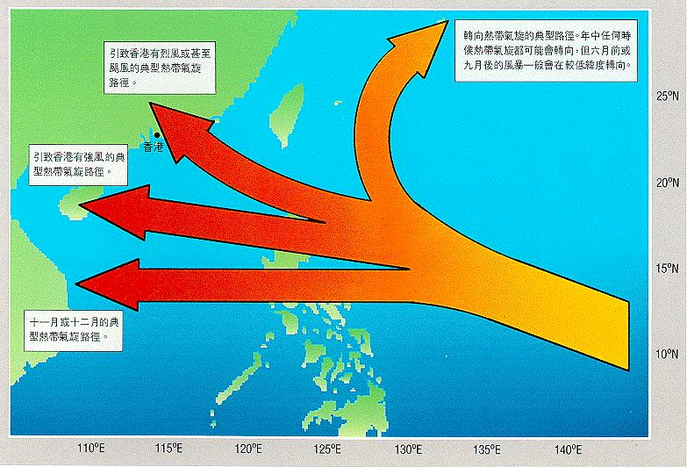

Slide 9
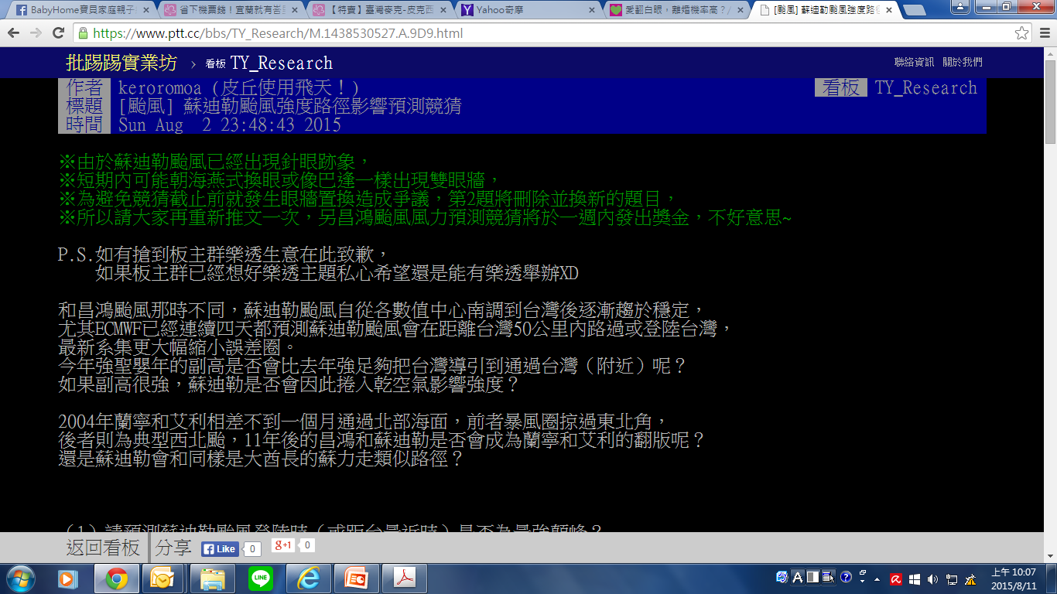
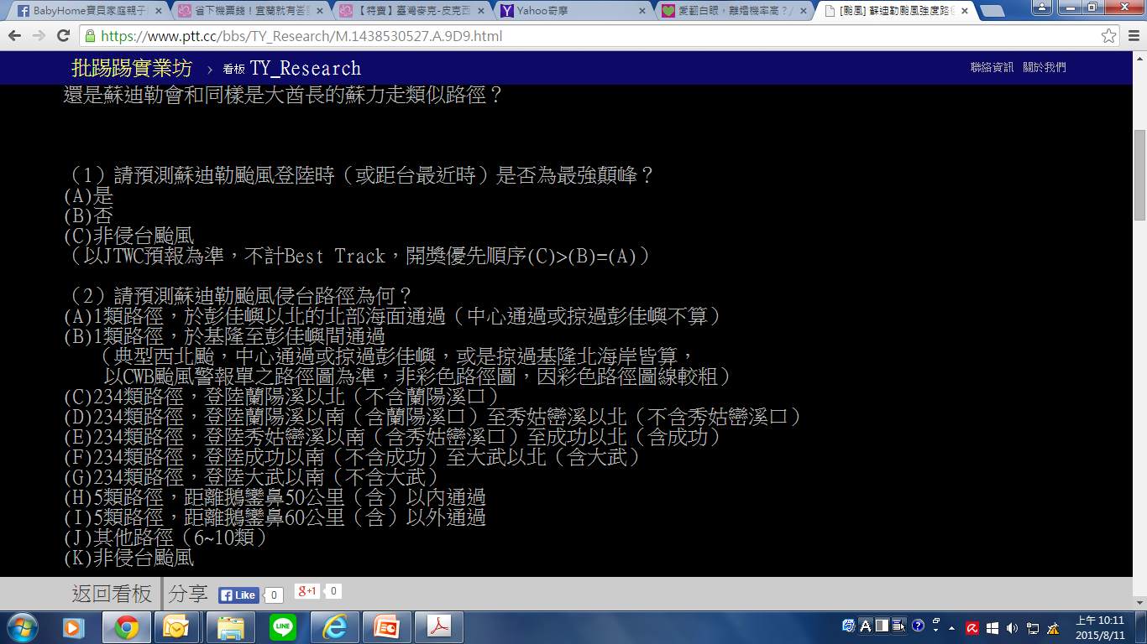
（1）請預測蘇迪勒颱風登陸時（或距台最近時）是否為最強顛峰？
https://www.ptt.cc/bbs/TY_Research/M.1438530527.A.9D9.html

Slide 10
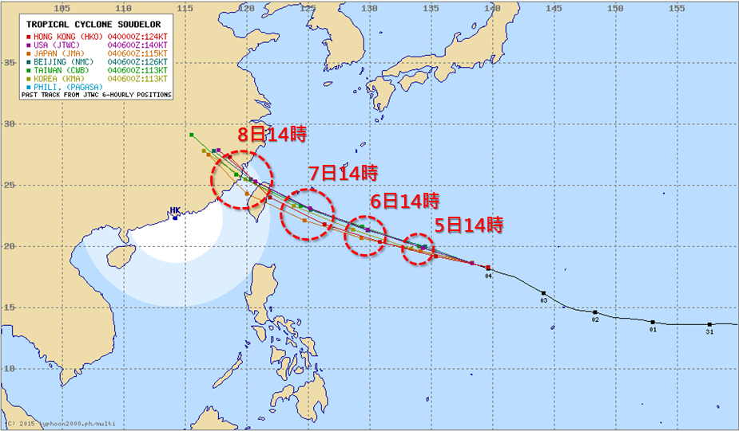
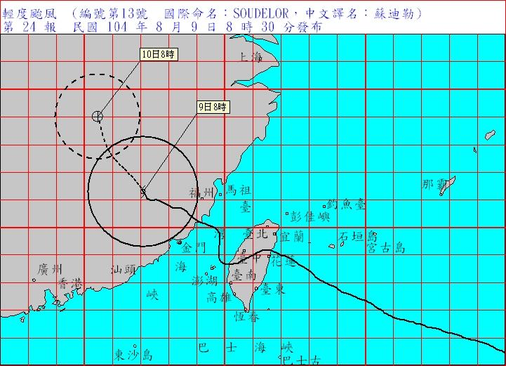
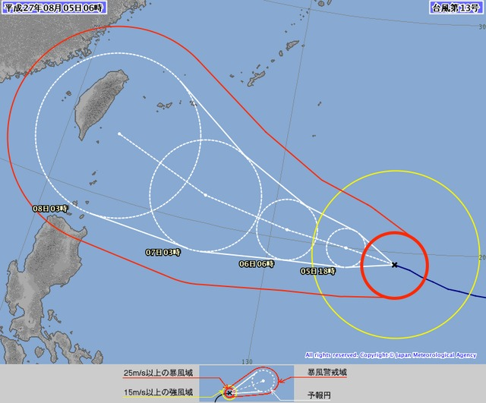
蘇迪勒颱風路徑預測

Slide 11
Section 4-1
Sample space & probability

Slide 12
Terminologies
Probability experiment
a chance process that leads to well-defined results called outcomes.
Outcome
The result of a single trial of a probability experiment.
Sample space
The set of all possible outcomes of a probability experiment.
Event
A collection of outcomes for the experiment, that is, any subset of the sample space.

Slide 13


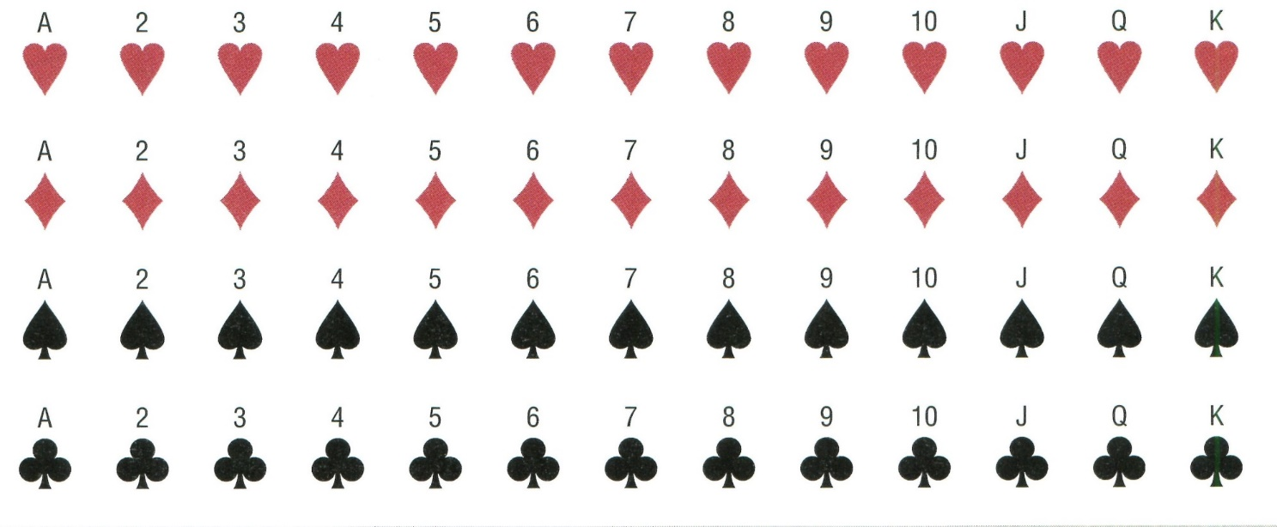
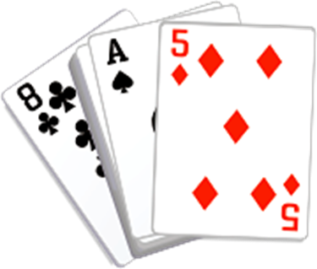
Sample Space Examples
Example 1: All 6 faces of a die:
Example 2: All 52 cards of a deck of cards:

Slide 14
Sample Spaces
Experiment
Sample Space
Toss a coin
Head,
Tail
Roll a die
1, 2, 3, 4, 5, 6
Answer a true/false
True, False
question
Toss two coins
HH,
HT, TH, TT

Slide 15
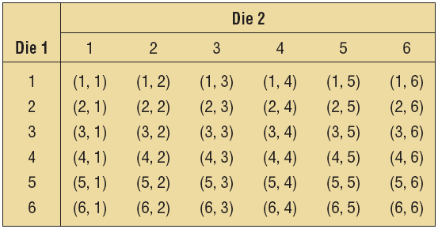
Example 4-1 : Rolling Dice
Find the sample space for rolling two dice.

Slide 16
Example 4-3: Gender of Children
Find the sample space for the gender of the children if a family has three children. Use B for boy and G for girl.
BBB BBG BGB BGG GBB GBG GGB GGG

Slide 17
Example 4-4: Gender of Children
Use a tree diagram to find the sample space for the gender of three children in a family.
B
BBB
BBG
BGB
BGG
GBB
GBG GGB GGG
B
G
B
B
G
G
B
B
G
G
B
G
G

Slide 18
Sample Spaces and Probability
There are three basic interpretations of probability:
Classical probability
Empirical probability
Subjective probability

Slide 19
Sample Spaces and Probability
Classical probability uses sample spaces to determine the numerical probability that an event will happen and assumes that all outcomes in the sample space are equally likely to occur.

Slide 20
Example 4-6: Gender of Children
If a family has three children, find the probability that two of the three children are girls.
Sample Space:
BBB BBG BGB BGG GBB GBG GGB GGG
Three outcomes (BGG, GBG, GGB) have two girls.
The probability of having two of three children being girls is 3/8.

Slide 21
Exercise: Rolling Dice
If two dice are rolled one time, find the probability of getting a sum of 7 or 11.

Slide 22
Probability Rule
Sample Spaces and Probability
Rule 1. The probability of any event E is a number (either a fraction or decimal) between and including 0 and 1.
This is denoted by 0 ≤ P(E) ≤ 1.
Rule 2. The sum of the probabilities of all the outcomes in the sample space is 1.
Rule 3. If an event E cannot occur (i.e., the event contains no members in the sample space), its probability is 0.
Rule 4.
If an event E is certain, then the probability of E is 1.
4.1
19

Slide 23
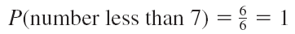
Exercise 4-9: Rolling a Die
When a single die is rolled, what is the probability of getting a number less than 7?
Since all outcomes—1, 2, 3, 4, 5, and 6—are less than 7, the probability is
The event of getting a number less than 7 is certain.

Slide 24
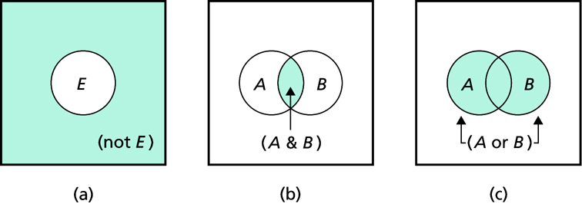
Sample Spaces and Probability

Slide 25
Example 4-11: Favorite Ice Cream Flavors
In a study, it was found that 23% of the people surveyed said that vanilla was their favorite flavor of ice cream. If a person is selected at random, find the probability that the person’s favorite flavor of ice cream is not vanilla.
P(not vanilla) = 1 - P(vanilla)
= 1 - 0.23 = 0.77 = 77%

Slide 26
Example: Finding Complements
Find the complement of each event.
Event
Complement of the Event
Rolling a die and getting a 4
Getting a 1, 2, 3, 5, or 6
Selecting a month and getting a
Getting February, March, April, May,
month that begins with a J
August, September, October,
November, or December
Selecting a day of the week and
Getting Saturday or Sunday
getting a weekday

Slide 27
Example: Residence of People
If the probability that a person lives in an industrialized country of the world is 1/5 , find the probability that a person does not live in an industrialized country.

Slide 28
Sample Spaces and Probability
There are three basic interpretations of probability:
Classical probability
Empirical probability
Subjective probability

Slide 29
Sample Spaces and Probability
Empirical probability relies on actual experience to determine the likelihood of outcomes.

Slide 30
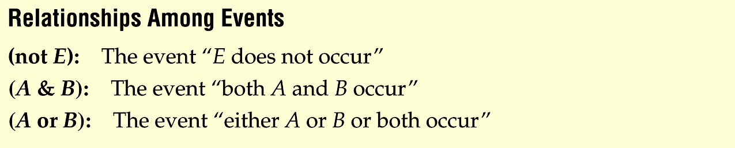
Venn’s diagram
Definition
Notes:
Change to page 161

Slide 31
Example 4-13: Blood Types
In a sample of 50 people, 21 had type O blood, 22 had type A blood, 5 had type B blood, and 2 had type AB blood. Set up a frequency distribution and find the following probabilities.
A person has type O blood.
A person has type A or type B blood.
A person has neither type A nor type O blood.
A person does not have type AB blood.

Slide 32
Example 4-13: Blood Types
In a sample of 50 people, 21 had type O blood, 22 had type A blood, 5 had type B blood, and 2 had type AB blood. Set up a frequency distribution and find the following probabilities.
a. A person has type O blood.
Type | Frequency
A | 22
B | 5
AB | 2
O | 21
Total 50

Slide 33
Example 4-13: Blood Types
In a sample of 50 people, 21 had type O blood, 22 had type A blood, 5 had type B blood, and 2 had type AB blood. Set up a frequency distribution and find the following probabilities.
b. A person has type A or type B blood.
Type | Frequency
A | 22
B | 5
AB | 2
O | 21
Total 50

Slide 34
Example 4-13: Blood Types
In a sample of 50 people, 21 had type O blood, 22 had type A blood, 5 had type B blood, and 2 had type AB blood. Set up a frequency distribution and find the following probabilities.
c. A person has neither type A nor type O blood.
Type | Frequency
A | 22
B | 5
AB | 2
O | 21
Total 50

Slide 35
Example 4-13: Blood Types
In a sample of 50 people, 21 had type O blood, 22 had type A blood, 5 had type B blood, and 2 had type AB blood. Set up a frequency distribution and find the following probabilities.
d. A person does not have type AB blood.
Type | Frequency
A | 22
B | 5
AB | 2
O | 21
Total 50

Slide 36
Sample Spaces and Probability
There are three basic interpretations of probability:
Classical probability
Empirical probability
Subjective probability

Slide 37
Sample Spaces and Probability
Subjective probability uses a probability value based on an educated guess or estimate, employing opinions and inexact information.
Examples: weather forecasting, predicting outcomes of sporting events

Slide 38
Example: Relationship Among Events
Playing Cards
A=the king of hearts
B=king
C=heart
D=face card
Question:
(not D)
(B & C)
(B or C)
(C & D)

Slide 39
Exercises
4-1
15, 16, 19, 21, 32, 35, 39, 44

Slide 40
Section 4-2
Addition Rules for Probability

Slide 41
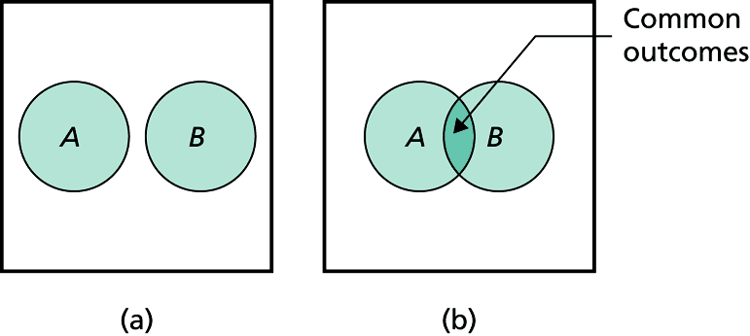
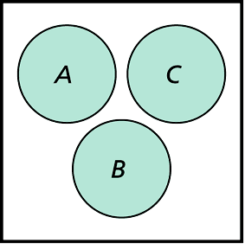
Definition: mutually exclusive events
Two events are mutually exclusive events if they cannot occur at the same time (i.e., they have no outcomes in common)

Slide 42
Addition Rules
Notes:
Change to page 164

Slide 43
Example 4-15: Determining Mutually Exclusive Events
Determine which events are mutually exclusive. Explain your answer.
a. Randomly selecting a female student
Randomly selecting a student who is a junior
b. Randomly selecting a person with type A blood
Randomly selecting a person with type O blood
c. Rolling a die and getting an odd number
Rolling a die and getting a number less than 3
d. Randomly selecting a person who is under 21 years of age
Randomly selecting a person who is over 30 years of age

Slide 44
Example 4-15: Determining Mutually Exclusive Events
Determine which events are mutually exclusive. Explain your answer.
a. Randomly selecting a female student
Randomly selecting a student who is a junior
These events are not mutually exclusive since a student can be both female and a junior.

Slide 45
Example 4-15: Determining Mutually Exclusive Events
Determine which events are mutually exclusive.
b. Randomly selecting a person with type A blood
Randomly selecting a person with type O blood
These events are mutually exclusive since a person cannot have type A blood and type O blood at the same time.

Slide 46
Example 4-15: Determining Mutually Exclusive Events
Determine which events are mutually exclusive.
c. Rolling a die and getting an odd number
Rolling a die and getting a number less than 3
These events are not mutually exclusive since the number 1 is both an odd number and a number less than 3.

Slide 47
Example 4-15: Determining Mutually Exclusive Events
Determine which events are mutually exclusive.
d. Randomly selecting a person who is under 21 years of age
Randomly selecting a person who is over 30 years of age
These events are mutually exclusive since a person cannot be both under 21 and over 30 years of age at the same time.

Slide 48
Example: Rolling a Die
Determine which events are mutually exclusive and which are not, when a single die is rolled.
a. Getting an odd number and getting an even number
b. Getting a 3 and getting an odd number
c. Getting an odd number and getting a number less than 4
d. Getting a number greater than 4 and getting a number less than 4

Slide 49
Example: Rolling a Die
Determine which events are mutually exclusive and which are not, when a single die is rolled.
a. Getting an odd number and getting an even number
Getting an odd number: 1, 3, or 5
Getting an even number: 2, 4, or 6
➔Mutually Exclusive

Slide 50
Example: Rolling a Die
Determine which events are mutually exclusive and which are not, when a single die is rolled.
b. Getting a 3 and getting an odd number
Getting a 3: 3
Getting an odd number: 1, 3, or 5
➔Not Mutually Exclusive

Slide 51
Example: Rolling a Die
Determine which events are mutually exclusive and which are not, when a single die is rolled.
c. Getting an odd number and getting a number less than 4
Getting an odd number: 1, 3, or 5
Getting a number less than 4: 1, 2, or 3
➔Not Mutually Exclusive

Slide 52
Example: Rolling a Die
Determine which events are mutually exclusive and which are not, when a single die is rolled.
d. Getting a number greater than 4 and getting a number less than 4
Getting a number greater than 4: 5 or 6
Getting a number less than 4: 1, 2, or 3
➔Mutually Exclusive

Slide 53
Example:
A day of the week is selected at random. Find the probability that it is a weekend day.
Mutually Exclusive Events

Slide 54
Example 4-21: Medical Staff
In a hospital unit there are 8 nurses and 5 physicians; 7 nurses and 3 physicians are females.
If a staff person is selected, find the probability that the subject is a nurse or a male.
Staff
Females
Males
Total
Nurses
7
1
8
Physicians
3
2
5
Total
10
3
13

Slide 55
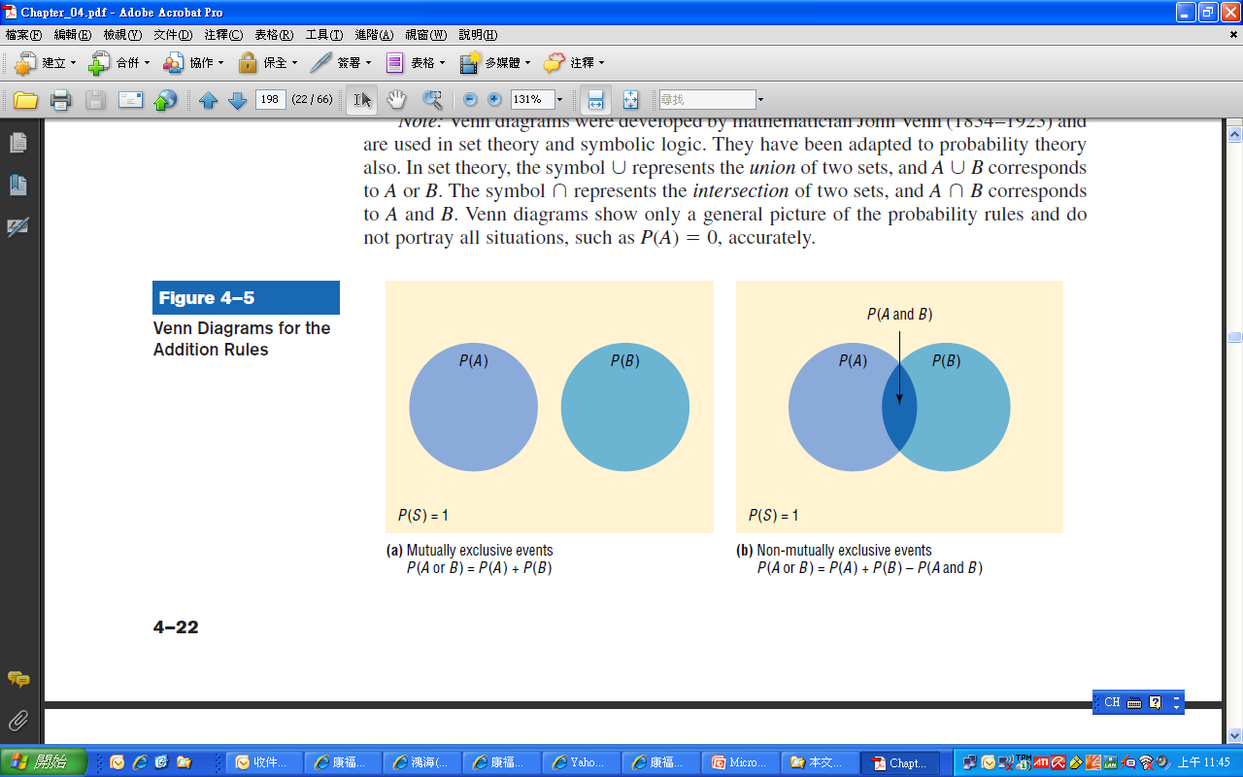

Slide 56
Exercises

Slide 57
Section 4-3
Multiplication Rules

Slide 58
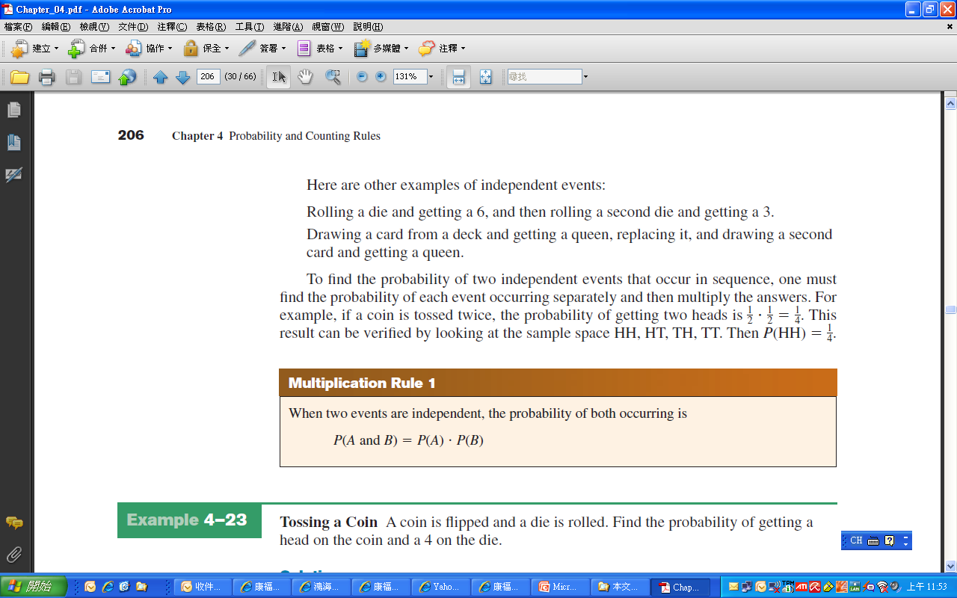
4.3 Multiplication Rules
Two events A and B are independent events if the fact that A occurs does not affect the probability of B occurring.

Slide 59
Example 4-23: Tossing a Coin
A coin is flipped and a die is rolled. Find the probability of getting a head on the coin and a 4 on the die.
This problem could be solved using sample space.
H1, H2, H3, H4, H5, H6, T1, T2, T3, T4, T5, T6

Slide 60
Example 4-26: Survey on Stress
A survey found that 46% of Americans say they suffer great stress at least once a week. If three people are selected at random, find the probability that all three will say that they suffer great stress at least once a week.

Slide 61
Definition
Conditional probability is the probability that the second event B occurs given that the first event A has occurred.

Slide 62
Example: Parking Tickets
The probability that Sam parks in a no-parking zone and gets a parking ticket is 0.06, and the probability that Sam cannot find a legal parking space and has to park in the no-parking zone is 0.20. On Tuesday, Sam arrives at school and has to park in a no-parking zone. Find the probability that he will get a parking ticket.
N= parking in a no-parking zone, T= getting a ticket

Slide 63
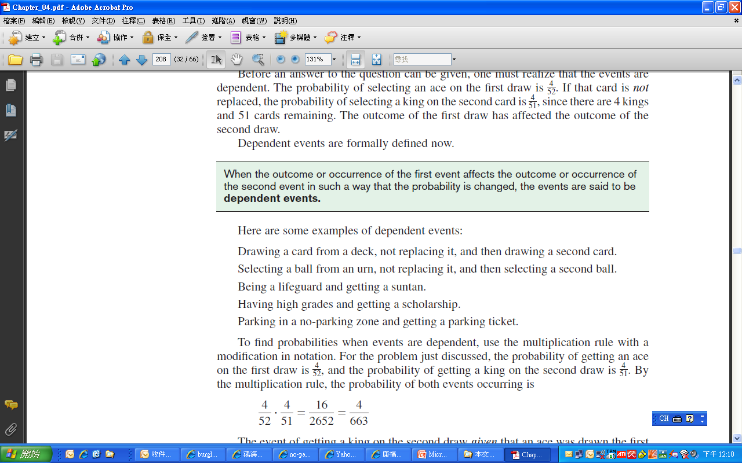
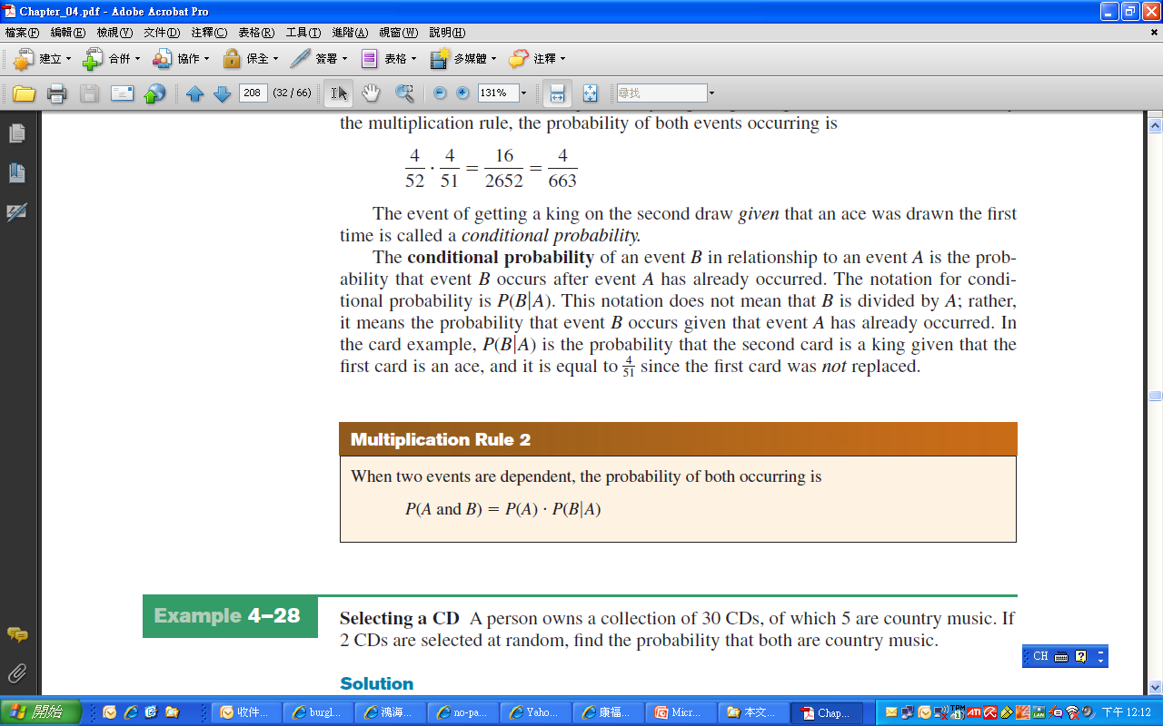
Definition: Dependent events

Slide 64
Example 4-28: Overqualified Workers
In a recent survey, 33% of the respondents said that they feel that they are overqualified (O) for their present job. Of these, 24% said that they were looking for a new job (J). If a person is selected at random, find the probability that the person feels that he or she is overqualified and is also looking for a new job.
P(O and J) = P(O) • P(J|O) = (0.33)(0.24) ≈ 0.079

Slide 65
Example 4-29: Homeowner’s & Automobile Insurance
World Wide Insurance company found that 53% of the residents of a city has homeowner’s insurance (H) with the company. Of these clients, 27% also has automobile insurance (A) with the company. If a resident is selected at random, find the probability that the resident has both homeowner’s and automobile insurance with World Wide Insurance Company.

Slide 66
Example: University Crime
At a university in western Pennsylvania, there were 5 burglaries reported in 2003, 16 in 2004, and 32 in 2005. If a researcher wishes to select at random two burglaries to further investigate, find the probability that both will have occurred in 2004.

Slide 67
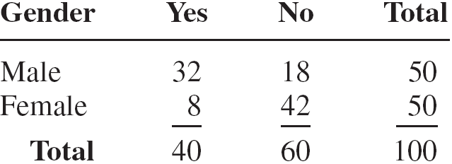
Example 4-34: Women in the Military
A recent survey asked 100 people if they thought women in the armed forces should be permitted to participate in combat. The results of the survey are shown.
a. Find the probability that the respondent answered yes (Y), given that the respondent was a female (F).
b. Find the probability that the respondent was a male (M), given that the respondent answered no (N).

Slide 68
Example 4-34: Women in the Military
a. Find the probability that the respondent answered yes (Y), given that the respondent was a female (F).

Slide 69
Example 4-34: Women in the Military
b. Find the probability that the respondent was a male (M), given that the respondent answered no (N).

Slide 70
Example 4-37: Ties
The Neckware Association of America reported that 3% of ties sold in the United States are bow ties (B). If 4 customers who purchased a tie are randomly selected, find the probability that at least 1 purchased a bow tie.

Slide 71
Multiplication Rules
Two events A and B are independent events if the fact that A occurs does not affect the probability of B occurring.

Slide 72
Section 4-4
Counting Rules

Slide 73
4.4 Counting Rules
The fundamental counting rule is also called the multiplication of choices.
In a sequence of n events in which the first one has k₁ possibilities and the second event has k₂ and the third has k₃, and so forth, the total number of possibilities of the sequence will be
k₁ · k₂ · k₃ · · · k_{n}

Slide 74
Example 4-39: Paint Colors
A paint manufacturer wishes to manufacture several different paints. The categories include
Color: red, blue, white, black, green, brown, yellow
Type: latex, oil
Texture: flat, semigloss, high gloss
Use: outdoor, indoor
How many different kinds of paint can be made if you can select one color, one type, one texture, and one use?

Slide 75
Counting Rules
Factorial is the product of all the positive numbers from 1 to a number.
Permutation is an arrangement of objects in a specific order. Order matters.

Slide 76
Counting Rules
Combination is a grouping of objects. Order does not matter.

Slide 77
Example 4-42: Business Locations
Suppose a business owner has a choice of 5 locations in which to establish her business. She decides to rank each location according to certain criteria, such as price of the store and parking facilities. How many different ways can she rank the 5 locations?
Using factorials, 5! = 120.
Using permutations, ₅P₅ = 120.

Slide 78
Example 4-43: Business Locations
Suppose the business owner in Example 4–42 wishes to rank only the top 3 of the 5 locations. How many different ways can she rank them?
Using permutations, ₅P₃ = 60.

Slide 79
Example: Television News Stories
A television news director wishes to use 3 news stories on an evening show. One story will be the lead story, one will be the second story, and the last will be a closing story. If the director has a total of 8 stories to choose from, how many possible ways can the program be set up?
Since there is a lead, second, and closing story, we know that order matters. We will use permutations.

Slide 80
Example 4-45: School Musical Plays
A school musical director can select 2 musical plays to present next year. One will be presented in the fall, and one will be presented in the spring. If she has 9 to pick from, how many different possibilities are there?
Order matters, so we will use permutations.

Slide 81
Example: School Musicals
A newspaper editor has received 8 books to review. He decides that he can use 3 reviews in his newspaper. How many different ways can these 3 reviews be selected?
The placement in the newspaper is not mentioned, so order does not matter. We will use combinations.

Slide 82
Example 4-49: Committee Selection
In a club there are 7 women and 5 men. A committee of 3 women and 2 men is to be chosen. How many different possibilities are there?
There are not separate roles listed for each committee member, so order does not matter. We will use combinations.
There are 35·10=350 different possibilities.

Slide 83
Supplement
Bayes’s Rule

Slide 84
貝氏定理
事前機率
事後機率
＋
額外資訊
(條件機率的形式)
貝氏定理的觀念

Slide 85
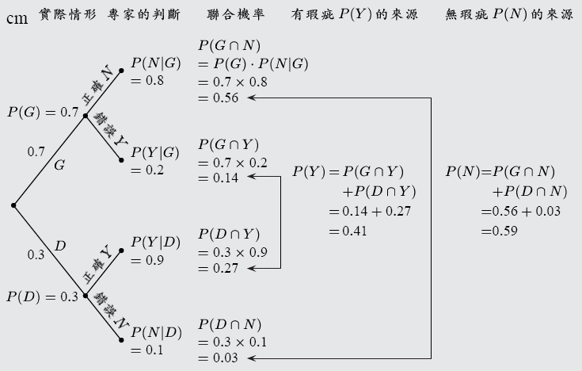
貝氏定理樹狀圖

Slide 86
貝氏定理
設實驗的出象(outcome)以兩種分類標準加以二重分割，按第一種分類標準分割為A與A’，另案第二種分類標準分割為B與B’，若P(B) ≠ 0, 則
B B’
A A’

Slide 87
機率總和定理 1/2
若事件B₁,B₂,…,B_{k}構成樣本空間S之一組分割，且P(B_{i})≠0,i=1,2,…,k；則對S中的任一事件A而言，下式成立：
P(A)=P(B₁)．P(A|B₁)+P(B₂)．P(A|B₂)
+…+P(B_{k})．P(A|B_{k}) (4-15)

Slide 88
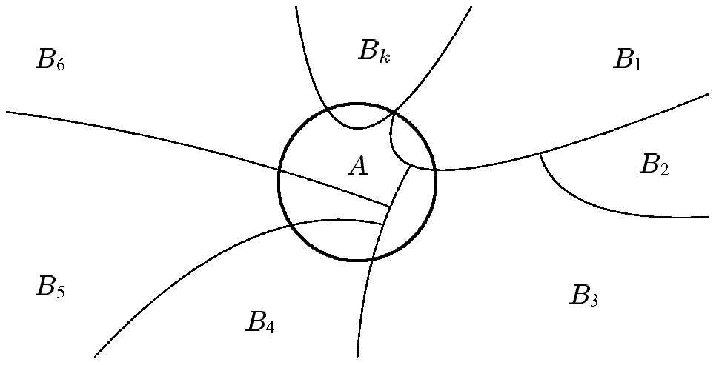
機率總和定理 2/2
機率總和定理的圖示

Slide 89
例
題
台泥公司用 A₁ 及 A₂ 兩部機器來製造產品，已知 A₁ 機器生產全部產品的40%， A₂ 生產佔全部產品的60%，若能獲得額外的資訊，知道 A₁ 和 A₂ 兩部機器所生產的產品不良率為4% 及5%，試求：
(a) 由全部產品中任意抽出一件，其為不良品的機率。
(b) 已知其為不良品，計算此產品來自 A₁ 機器的機率。
解：(a) 我們可依題意，先繪出樹枝圖 ( 設B為不良品 )
Source:江建良，統計學，高立圖書

Slide 90
例
題
台泥公司用 A₁ 及 A₂ 兩部機器來製造產品，已知 A₁ 機器生產全部產品的40%， A₂ 生產佔全部產品的60%，若能獲得額外的資訊，知道 A₁ 和 A₂ 兩部機器所生產的產品不良率為4% 及5%，試求：
(a) 由全部產品中任意抽出一件，其為不良品的機率。
(b) 已知其為不良品，計算此產品來自 A₁ 機器的機率。
解：(b) 已知其為不良品，計算此產品來自 A₁ 機器的機率。
Source:江建良，統計學，高立圖書

Slide 91
我們亦可將貝氏定理列成下表
 事件 A _{i} |  事前機率 P(A _{i}) |  條件機率 P(B | A _{i}) |  聯合機率 P(A _{i}∩ B) |  事後機率 P(A _{i} | B)
A₁ | 0.4 | 0.04 | 0.016 | 0.016/0.046=0.3478
A₂ | 0.6 | 0.05 | 0.030 | 0.03/0.046=0.6522
 | 1.0 |  | 0.016 | 1.0000
由本表我們更容易看出，若我們不獲得額外資料的機率，則對不良品來自 A₁ 機器的機率判斷為 P (A₁) = 0.4 ( 事前機率 )，但有額外資訊 ( 以條件機率 P (B∣A₁ ) = 0.04 表示 ) 加入後，則對不良品來自 A₁ 機器的機率，修正為 P (A₁∣B) = 0.3478 ( 事後機率 )。
Source:江建良，統計學，高立圖書

Slide 92
例
題
小明可搭乘 四路車到學校上學，搭車的比例分別為40%、30%、20%、10%，而遲到的機率依次為1.0%、2.0%、1.6%、1.4%，假設今天早上遲到了，則小明搭上 A₃ 車上學的機率為何？
解：(a) 若本題無額外的遲到資訊，我們很自然地會利用事前機率求解，即
(b) 若我們利用“遲到的資訊”，則為
(c) 原先之事前機率為0.2，經遲到資訊的加入，機率修正為0.2192 ( 事後機率 )。
Source:江建良，統計學，高立圖書

Slide 93
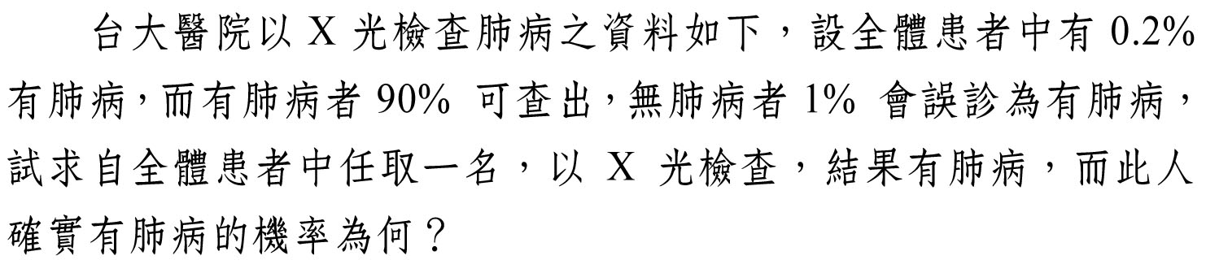
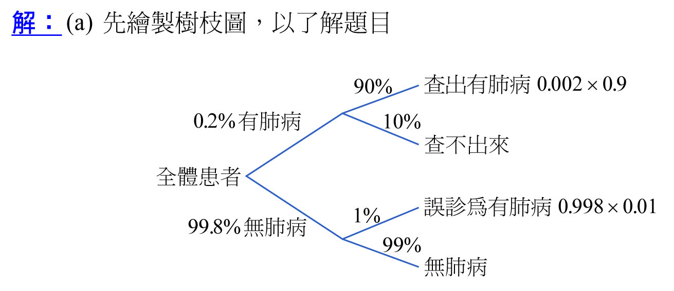
例
題

Slide 94
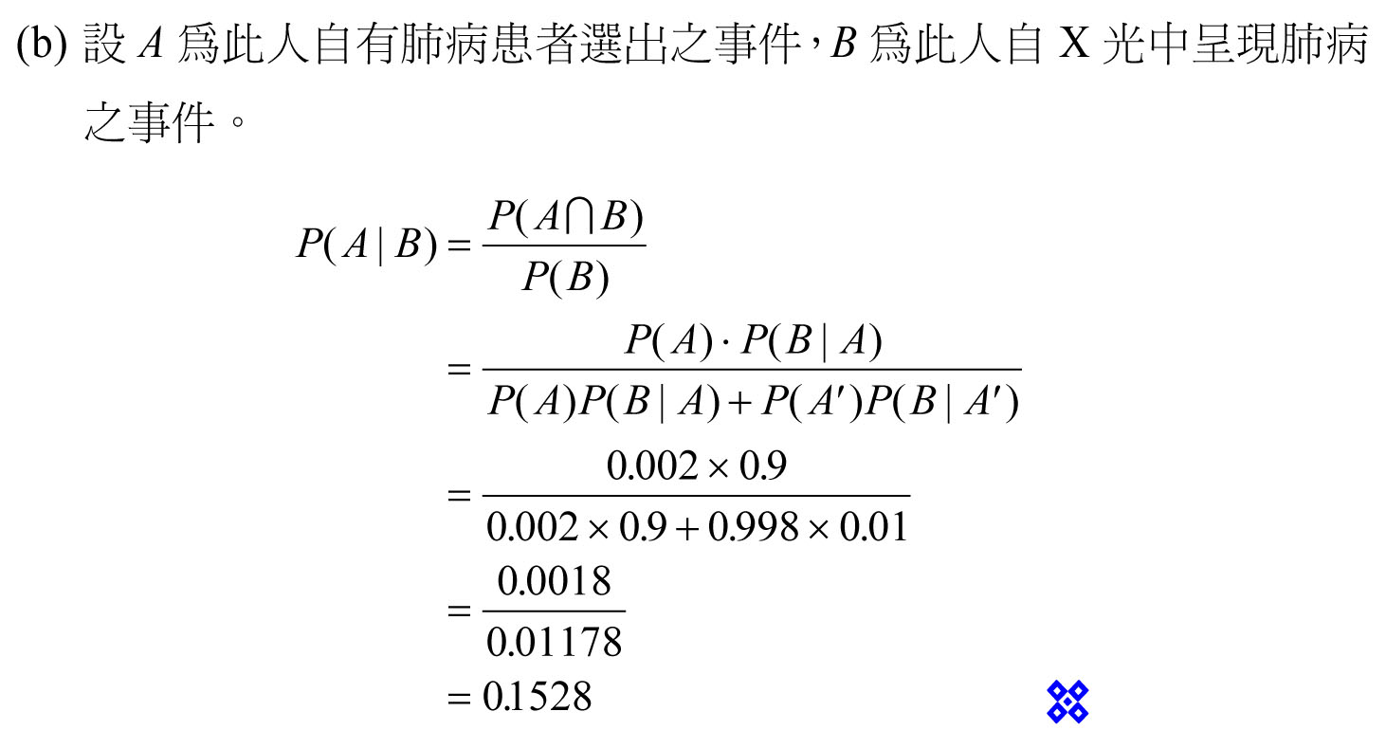
Source:江建良，統計學，高立圖書

Slide 95
一般形式的貝氏定理 1/3
若事件B₁,B₂,…,B_{k}構成樣本空間S的一組分割，且P(B_{i})≠0,i=1,2,…,k；則對S中的任一事件P(A)≠0而言，
(4-16)

Slide 96
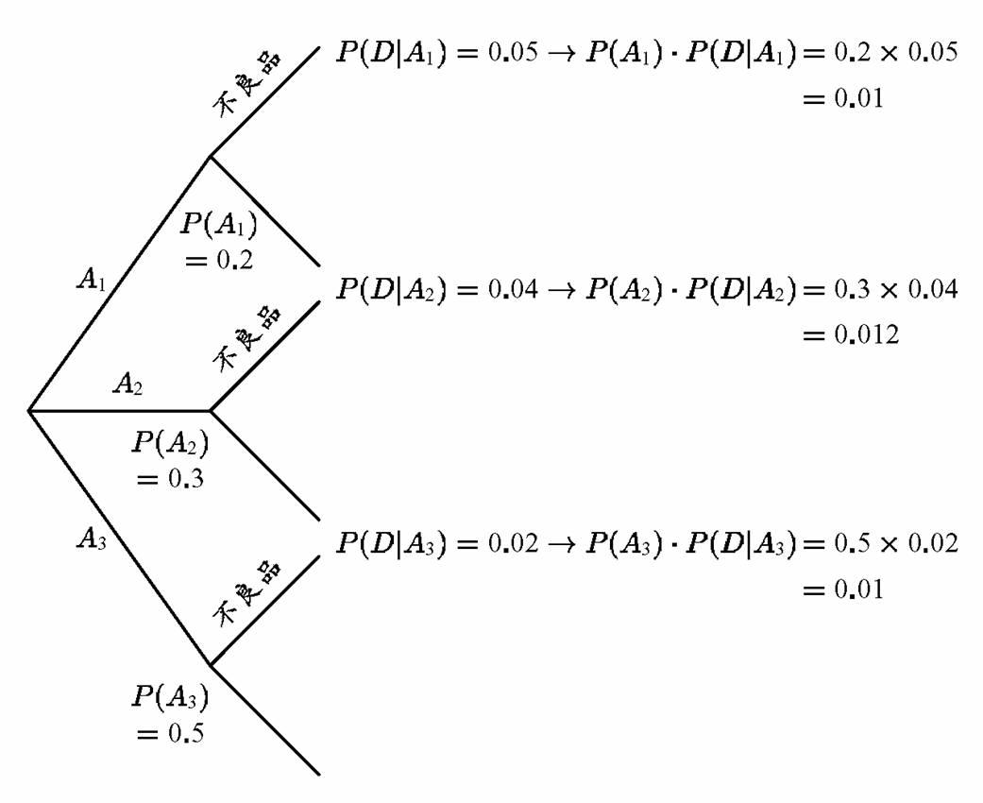
一般形式的貝氏定理例題 2/3

Slide 97
一般形式的貝氏定理例題 3/3
表4.5 例題4.22之貝氏定理的列表分析
(1) 事件 A_{i} | (2) 事前機率 P(A_{i}) | (3) 條件機率 P(D|A_{i}) | (4) 聯合機率 P(A_{i}∩D) | (5) 事後機率 P(A_{i}|D)
A₁ | 02 | 0.05 | 0.01 | 0.01/0.032=0.3125
A₂ | 0.3 | 0.04 | 0.012 | 0.012/0.032=0.375
A₃ | 0.5 | 0.02 | 0.01 | 0.01/0.032=0.3125
 | 1.00 |  | P(D)=0.032 | 1.000

Slide 98
Exmaple
一工廠有甲、乙兩條生產線生產同一種產品，甲產能為60%, 乙產能為40%, 甲生產線之不良率為1%, 乙為2%。今隨機抽取一件產品正好為不良品，請問其由甲生產之機率為何？

Slide 99
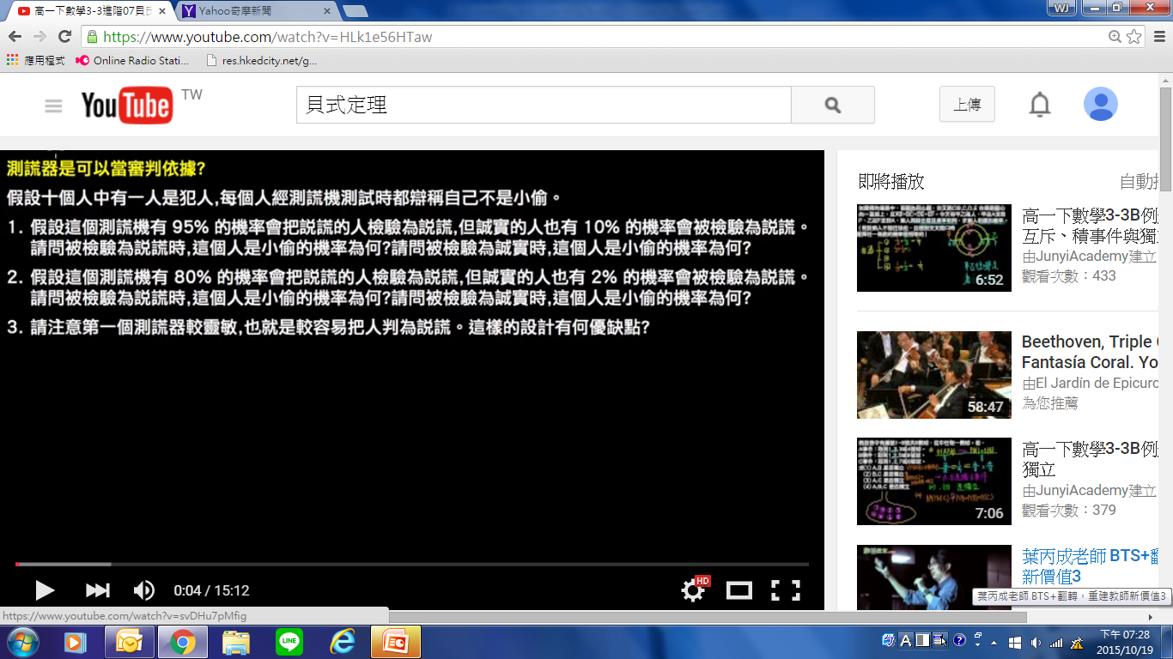
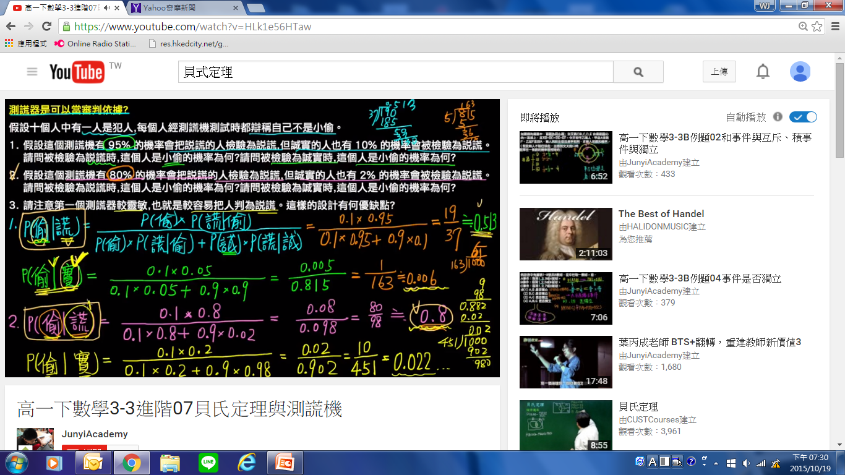

Slide 100
Exercises
4-1
15, 16, 19, 21, 32, 35, 39, 44
4-2
4, 5, 11, 21, 27, 29, 32
4-3
1, 2, 8, 17, 18, 22, 27, 29, 34, 41, 52, 56

